Slide 1
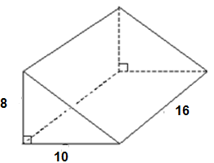
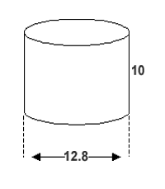
Warm up
Which solid has more volume?
Show work as evidence.
The cylinder has more volume.

Slide 2
Cavalieri’s Principle
The volumes of two objects are equal if the areas of their corresponding cross sections are equal

Slide 3
Cavalieri’s Principle Examples
These pieces maintain their SAME volume regardless of how they are moved.

Slide 4
Cavalieri’s Principle Examples

Slide 5
Cavalieri’s Principle Examples
The same volume formula applies whether it’s a right prism or an oblique prism.
V = Bh

Slide 6
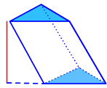
Example 1: Which solid has more volume? Use Cavalieri’s Principle.
20 in.
20 in.
4 in.
8 in.
6 in.
6 in.
The area of the cross sections are both 24in² and have the same height of 20, so the solids have the SAME volume.

Slide 7
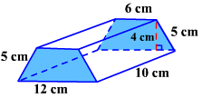
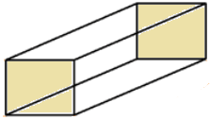
Example 2: Which solid has more volume? Use Cavalieri’s Principle.
6 cm
10 cm
6 cm
The area of the cross sections are both 36cm² and have the same height of 10, so the solids have the SAME volume.

Slide 8
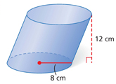
3. Find the volume to the nearest tenth.

Slide 9
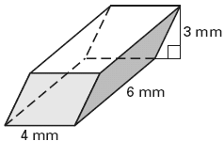
4. Find the volume to the nearest tenth.

Slide 10
Versa Tiles Worksheet
12 problems Find the Volume

Slide 11
Homework
Review Sheet
Test Friday!

