Slide 1
Warm-up
Solve for y. Are any of the lines parallel or perpendicular?
2x + 3y = 5
4x – 2y = 8
x – ½ y = 6

Slide 2
Area and Perimeter

Slide 3
Perimeter
Distance AROUND the shape

Slide 4
Area
Amount of space INSIDE the boundary

Slide 5
Area Formulas
Triangle: A = ½ bh
Rectangle: A = bh
Parallelogram: A = bh
Trapezoid: A = ½ (b₁ + b₂)h

Slide 6
Find the perimeter. Q1 of 12

Slide 7
Find the perimeter. Q2 of 12

Slide 8
Find the perimeter. Q3 of 12

Slide 9
Find the area. Q4 of 12

Slide 10
Find the area. Q5 of 12

Slide 11
Find the area. Q6 of 12

Slide 12
Find the area. Q7 of 12

Slide 13
Find the area. Q8 of 12

Slide 14
Perimeter & Area on the Coordinate Plane

Slide 15
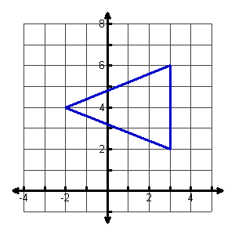
Find the area. Q9 of 12

Slide 16
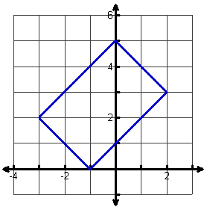
Find the perimeter. Q10 of 12

Slide 17
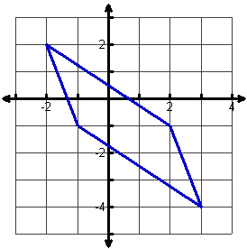
Find the perimeter. Q11 of 12

Slide 18
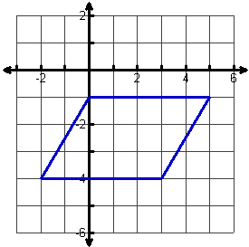
Find the area. Q12 of 12

Slide 19
Classwork
Perimeter Worksheet

Slide 20
Homework
Area Worksheet

Slide 21
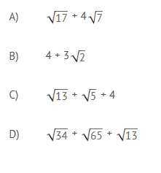
Warm - Up

