Slide 1

Volume of
Pyramids and
Cones

Slide 2
Volume Formula for Cones & Pyramids

Slide 3
Find the volume.
8 ft
10 ft
12 ft

Slide 4
What is the volume of this cone?
Round to the nearest tenth.
3.6 cm
3 cm
2 cm

Slide 5
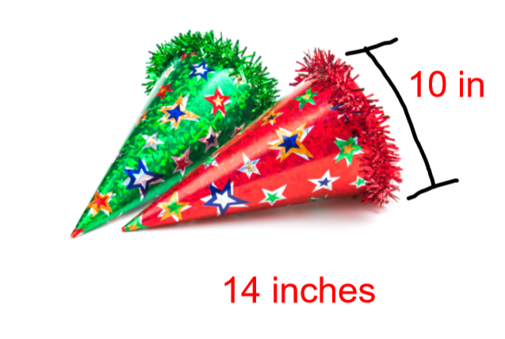
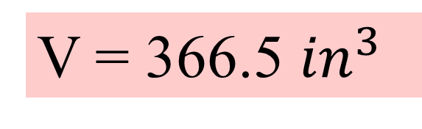
You Try!
Find the volume of the party hat!
Round to the tenths place
V = 366.5 ${in}^{3}$

Slide 6
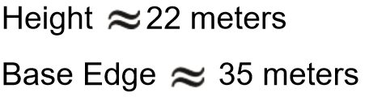
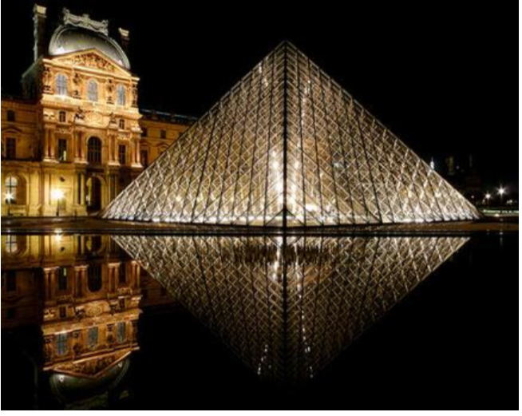
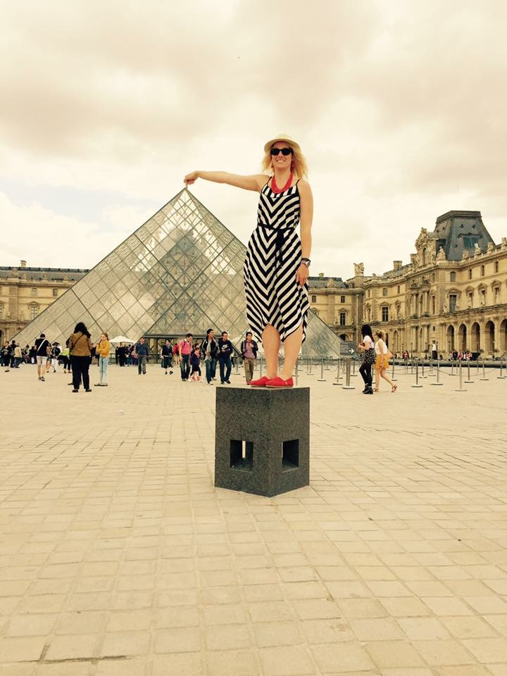
Find the volume of the pyramid.
This is a glass pyramid at the Louvre Museum in Paris, France. What famous painting is housed here?

Slide 7
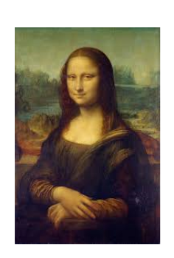
Mona Lisa
Leonardo da Vinci

Slide 8

Working Backwards
Find the height of a cone with a volume of 20 ${ft}^{3}$and a radius of 4 ft.

Slide 9
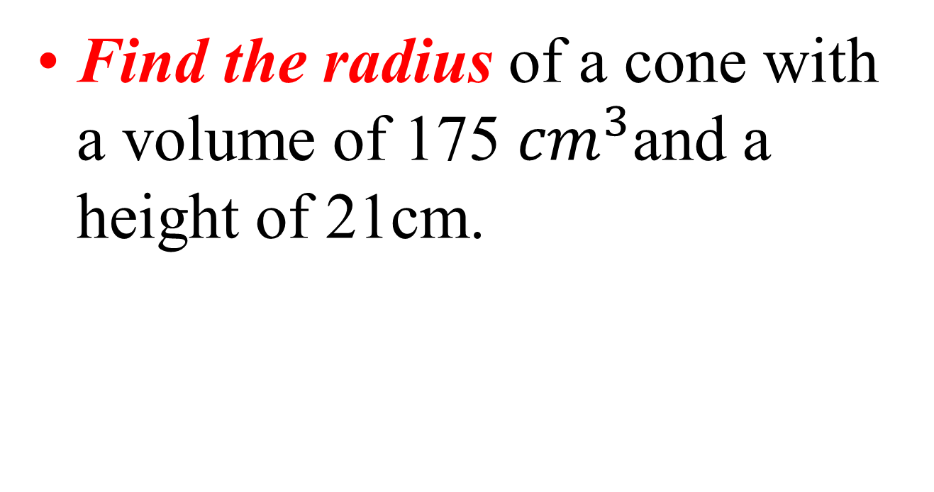
Working Backwards
Find the radius of a cone with a volume of 175 ${cm}^{3}$and a height of 21cm.

Slide 10
Homework
1 – 15

