Slide 1
Rational functions
Unit 7:Rationals and radicals

Slide 2
Horizontal Asymptotes
Zeros
Y – Intercept
Holes
Vertical Asymptotes
Slant Asymptote

Slide 3
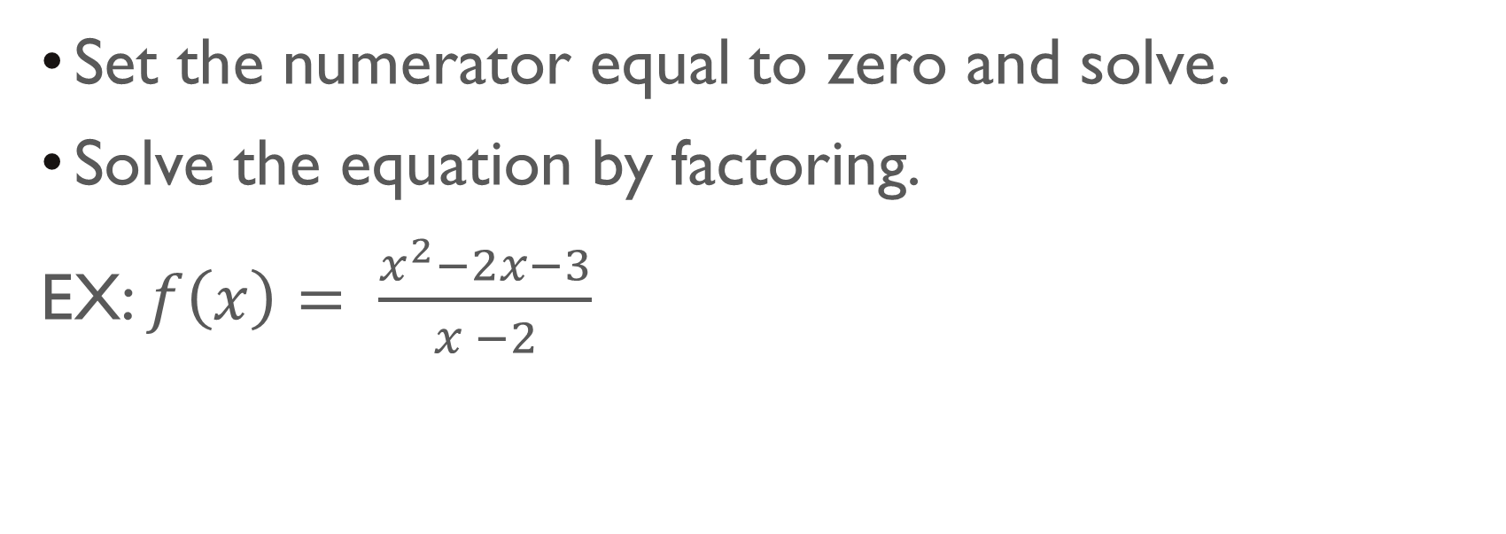
Finding zeros: (#,0)
Set the numerator equal to zero and solve.
Solve the equation by factoring.
EX: $f\left(x\right)= \frac{x^{2}−2x−3}{x −2}$
$$= \frac{(x −3)(x+1)}{(x −2)}$$
The numerator is 0 when x = -1 or x = 3

Slide 4
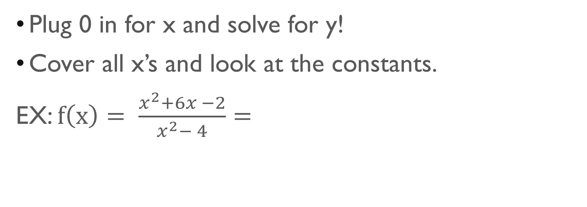


Finding y-intercept: (0,#)
Plug 0 in for x and solve for y!
Cover all x’s and look at the constants.
EX: $f\left(x\right)= \frac{x^{2}+6x −2}{x^{2}− 4}=$
$$\frac{−2}{−4}= \frac{1}{2}$$
$$=(0,\frac{1}{2} )$$

Slide 5
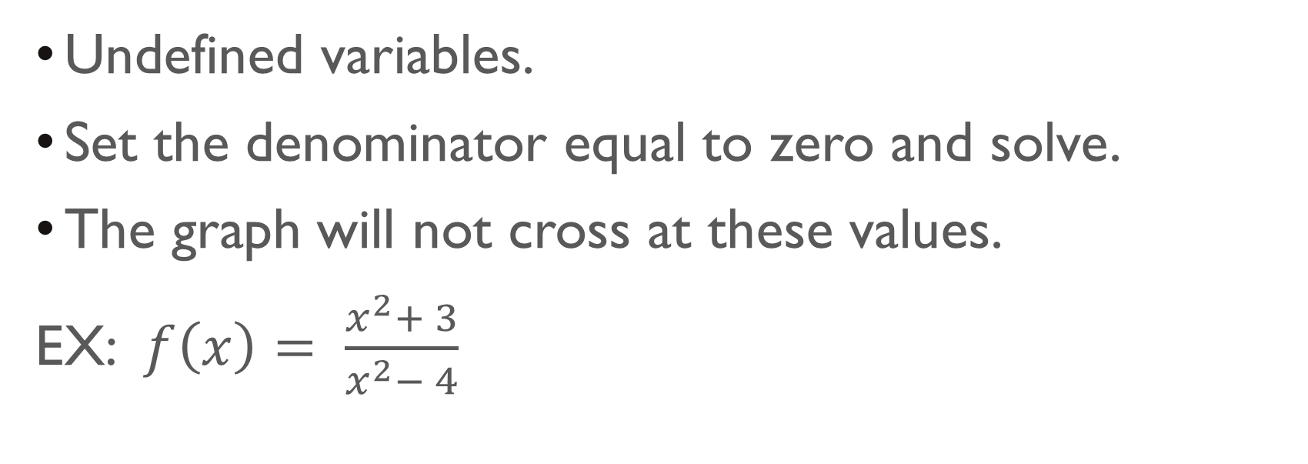
Vertical Asymptotes: X = #
Undefined variables.
Set the denominator equal to zero and solve.
The graph will not cross at these values.
EX: $f\left(x\right)= \frac{x^{2}+ 3}{x^{2}− 4}$
= (x + 2)(x – 2) =
This expression will have two vertical asymptotes
x = - 2 or x = 2

Slide 6
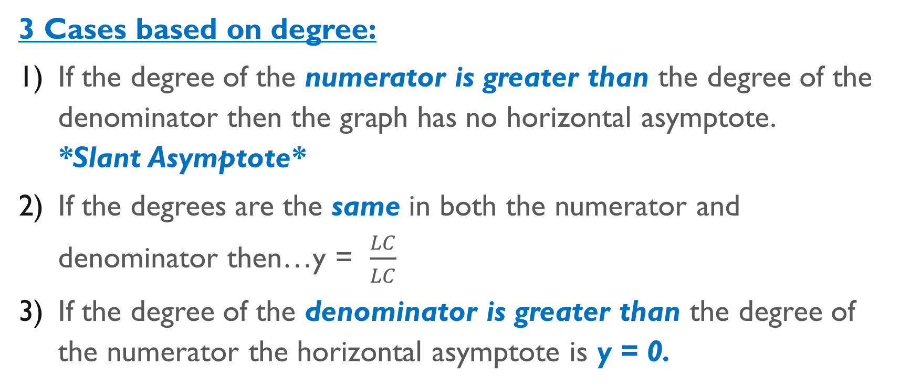
Horizontal Asymptotes: Y = #
3 Cases based on degree:
If the degree of the numerator is greater than the degree of the denominator then the graph has no horizontal asymptote. *Slant Asymptote*
If the degrees are the same in both the numerator and denominator then…y = $\frac{LC}{LC}$
If the degree of the denominator is greater than the degree of the numerator the horizontal asymptote is y = 0.

Slide 7
Holes: x = #
To find a hole in a rational function, we look for a common factor in both the numerator and denominator.
EX: $f\left(x\right)= \frac{x^{2} + x − 6 }{x^{2} − 4 }$ = $\frac{(x+3)(x −2)}{(x+2)(x −2)}$
Hole at x = 2
To find y – value: Plug x = 2 into the simplified expression.
f(2) =
Look at graphing calculator. If you evaluate x = 2 you will see a blank.

Slide 8
Slant asymptote: y= mx + B
A slant asymptote occurs when the polynomial in the numerator is a higher degree than the polynomial in the denominator.
To find the slant asymptote you must divide the numerator by the denominator using either long division or synthetic division.
EX: $f\left(x\right)= \frac{x^{2}− 6x + 7}{x + 5}$ =
y = x – 11

