Slide 1
Warm - Up
Solve for the missing angle:
Solve for the missing arc:

Slide 2
Homework Answers
What did the Mama Lion say when she saw her cub chasing a hunter around a tree?
“How many times have I told you not to play with your food?”

Slide 3

Tangent & Secant Segments

Slide 4
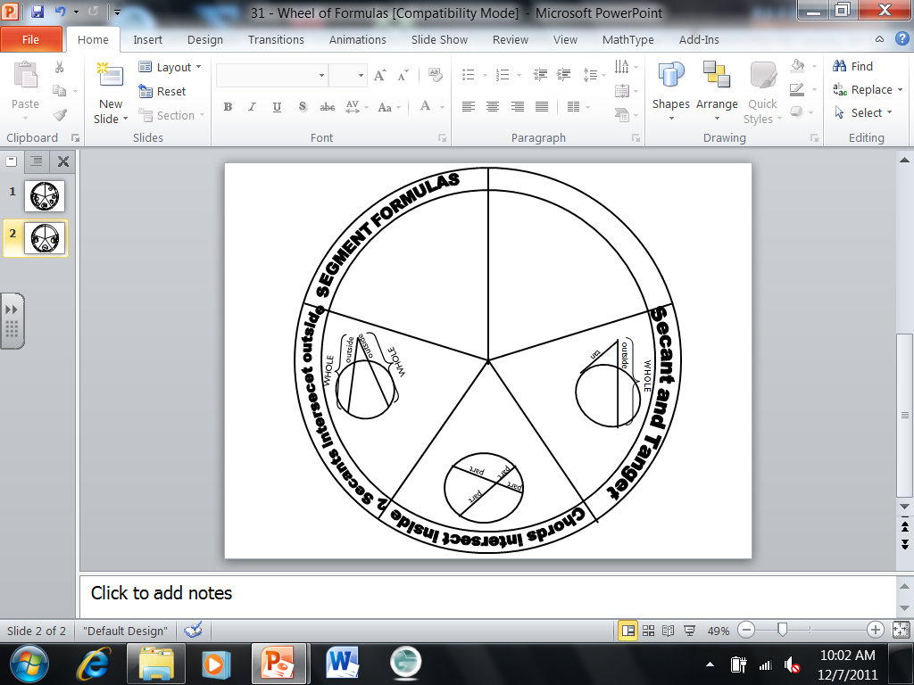
Two secants intersect
OUTSIDE the circle

Slide 5
Ex: 1 Solve for x.
13
7
4
x
7(7 + 13) = 4 (4 + x)
140 = 16 + 4x
x = 31
124 = 4x

Slide 6
Ex: 2 Solve for x.
x
5
6
6(14) = 5(x + 5)
14
84 = 25 + 5x
x = 11.8
59 = 5x

Slide 7
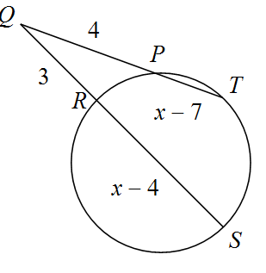
Ex: 3 Solve for x.
4(x – 3) = 3(x – 1)
4x – 12 = 3x – 3
x = 9
x – 12 = – 3

Slide 8
Secant and Tangent

Slide 9
Ex: 4 Solve for x.
x
12
24
24² = 12(12 + x)
576 = 144 + 12x
x = 36

Slide 10
Ex: 5
20
15
x
x² = 5(20)
x² = 100
x = 10

Slide 11
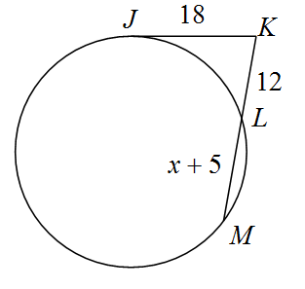
Ex: 6 Find KM.
18² = 12(x + 17)
324 = 12x + 204
x = 10
KM = 27

Slide 12
Homework: 6.6 worksheet
Front only complete: 2,4,7,9, 19, 21
Back: Skip 4 - 6

